Slide 1
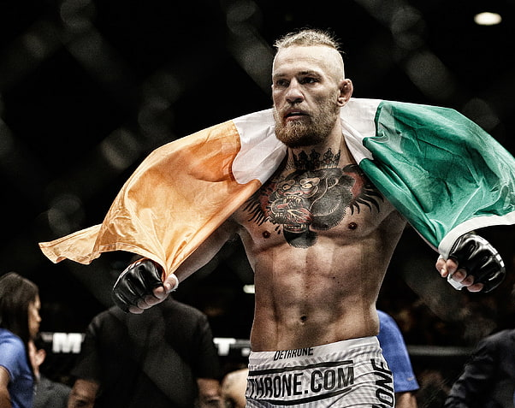
UFC FIGHTS RESULTS

Slide 2
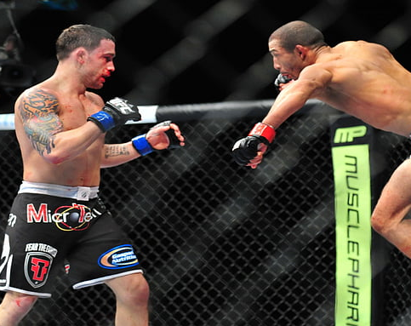
2122 fighters have participated in UFC fights

Slide 3
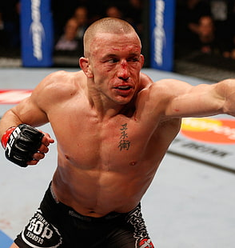

The oldest one was almost 52 years

Slide 4

A total of 555 fights was organized by UFC

Slide 5

The most events were held in Las Vegas(152)
This Photo by Unknown Author is licensed under CC BY-SA

Slide 6
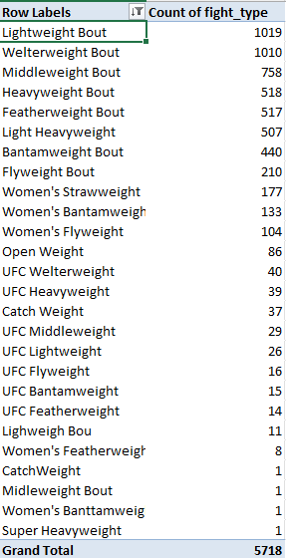
How many fights were fought in each weight class?

Slide 7
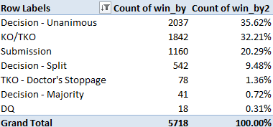
How were the fights finished and what was the finish rate expressed in percentages?

Slide 8
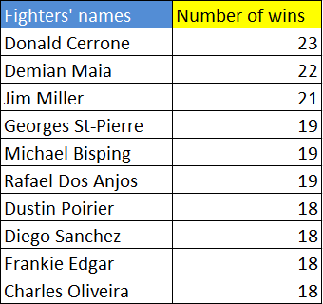
I have created a list of the greatest fighters of all time. If some fighters have the same number of wins, sort their names alphabetically

Slide 9
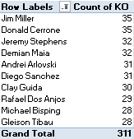
Which fighters can be considered the best strikers? Sort them by their number of KOs.

